Slide 1



Android Notes Sharing Application
Team Members:
Arvind Negi
Sohan Kathait
Amit Kishor Raturi

Slide 2

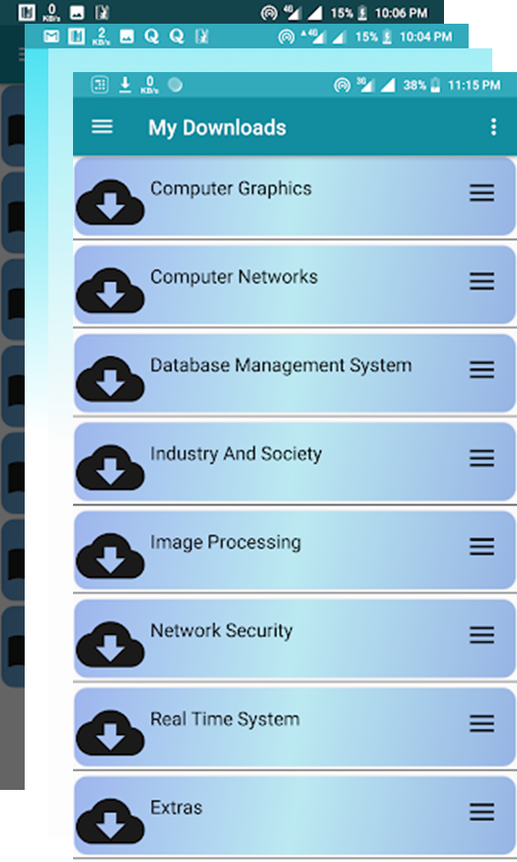
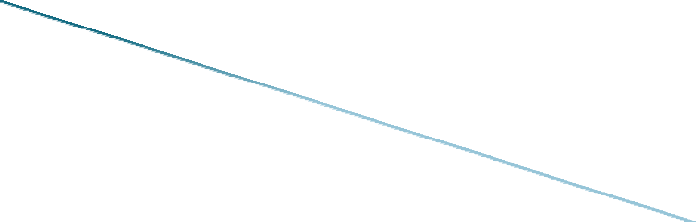

Project Objective
Overview Of Project
How It Works?
Authentication Service
Upload Service
Download Service
References

Slide 3

 To develop an Interactive Android app to :
Enable students to share the study related material in a more organized fashion.
Enable students to keep the digitized version of their notes and study material saved on the cloud in a well organized manner for future references(GATE preparation etc.)
Enhance our development skills using the simple and cheaper platform like Android.

Slide 4
Overview Of Project
An online platform in the form of an android app where students can share lecture notes, books and other study related stuff.
Developed using Android SDK and some third party libraries with JAVA 8 being the driver language for the business logic and XML for creating the GUI.
MVC software design pattern is used to keep the code clean and well structured.

Slide 5





How It Works?
User Interface
Authentication
Authentication with google API
Meta data for requested content/Entry of the meta data for new content
Notes Upload Request
Real Time
Database
Student
Firebase
API
Notes Download Request
Getting the requested file/Saving the new file
Android SDK
Firebase
Storage
Linux Kernel
Enquired Notes/Upload successful Response

Slide 6
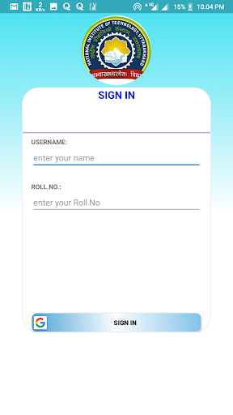
User Authentication
Done with the google account of the user.
Google API is used to accomplish the task.
A username and Roll no. is asked from the student which is saved to the firebase database.
The google API fires an Intent( A java object used to communicate b/w the different components of an application) which opens a screen for choosing the google account to sign in with.

Slide 7
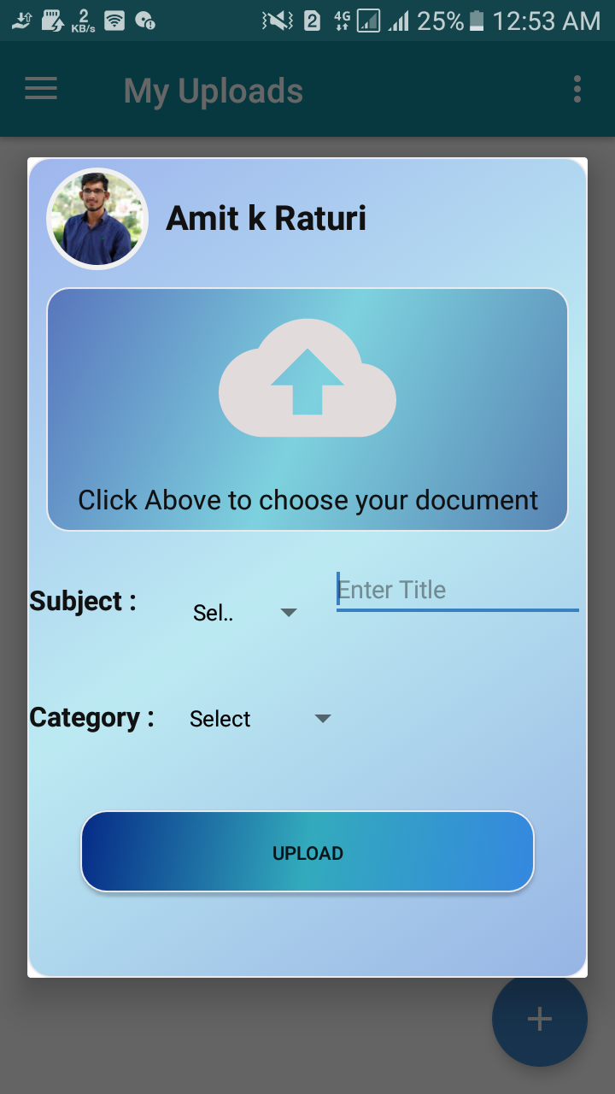
Upload Service
User selects a file from the file system and choose the subject and category to which it belongs to using the GUI provided.
The upload service make use of Firebase services viz. Real time database and Firebase storage to save the student uploaded notes into the google cloud.
The metadata of the files is saved to the Real time database in a tree like structure, such as its download URL , name , size etc. while the file itself resides in the firebase storage.
Firebase client SDK provides rich set of APIs to communicate with the firebase backend.

Slide 8
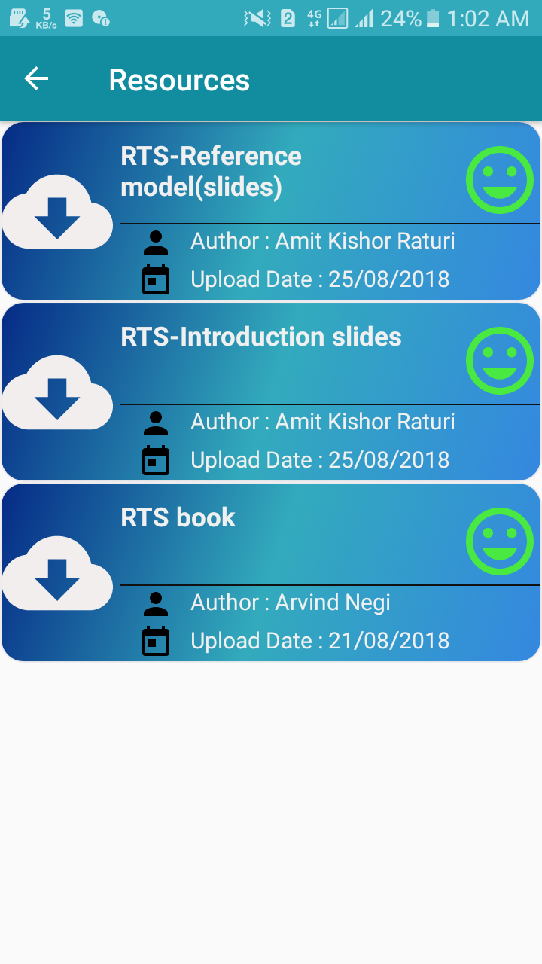
Download Service
User can select a file from the proper sections displayed using a GUI to download it from the storage.
The metadata is fetched from the firebase database to show all the file information.
Android Download Manager API from Android SDK is used to download the selected file using the firebase storage URL.

Slide 9
USER INTERFACE
ListView
Adapter
Navigation Drawer
Dialog Fragment
Recycler view
Fragment BackStack

Slide 10
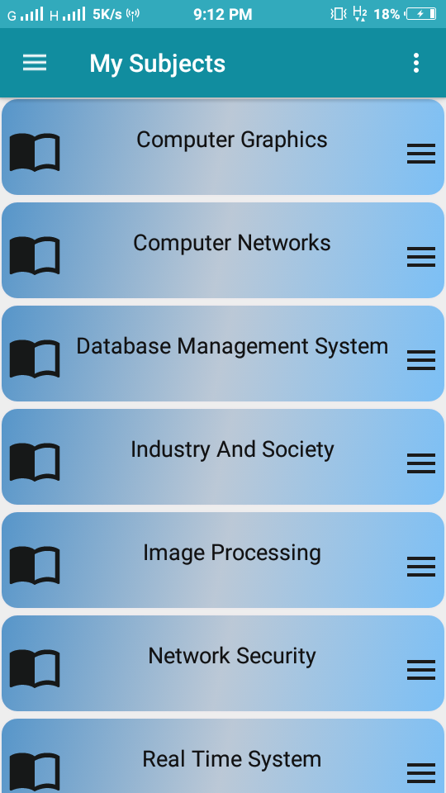
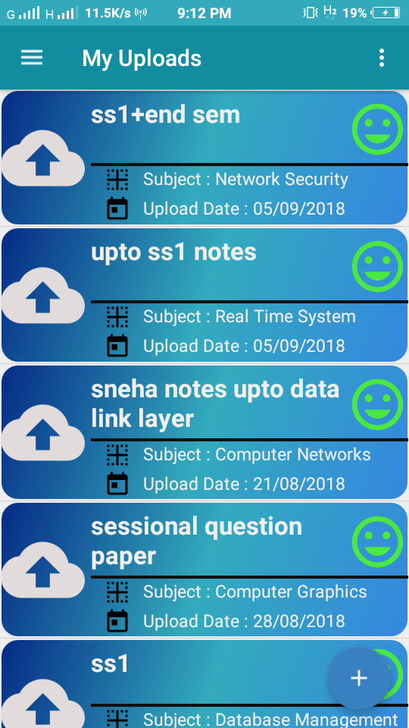
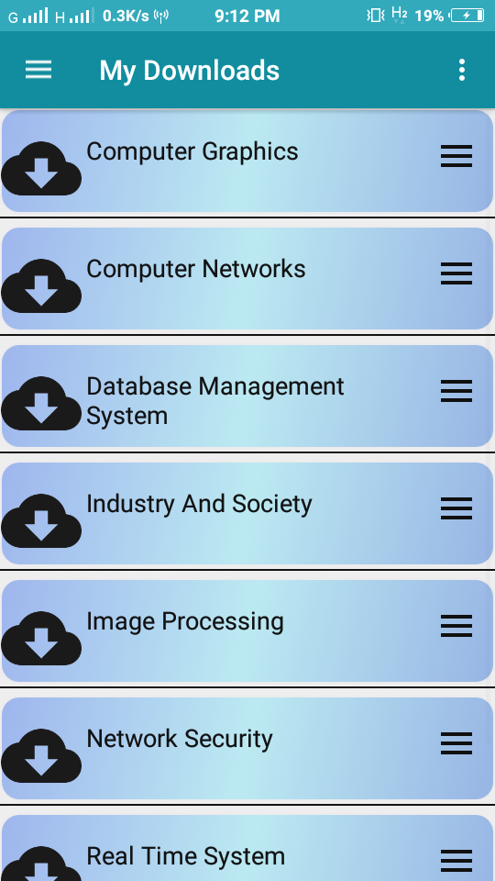
1- Listview
Listview is a view group that displays a list of scrollable items.

Slide 11
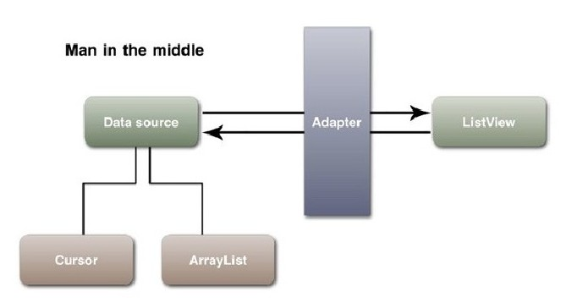
2- Adapters
Used to bind the data with the view such as with the list view or recycler view.
Bridge between UI component and the data source.

Slide 12
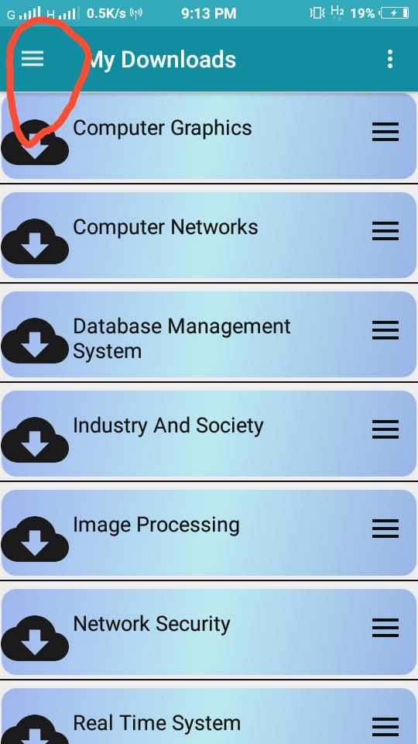
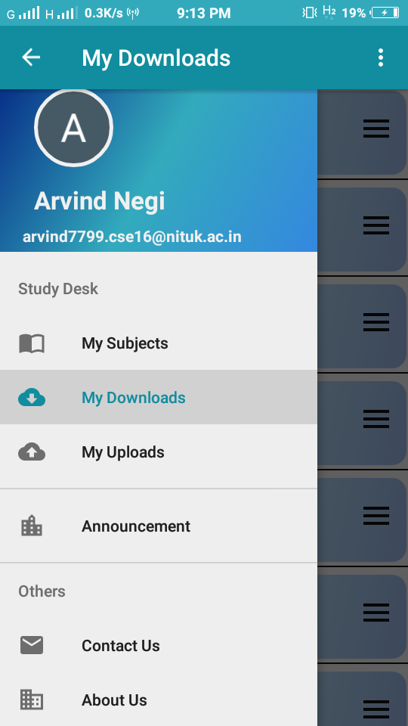
3- Navigation Drawer
Android navigation drawer is a sliding left menu that is used to display important links in the application.

Slide 13
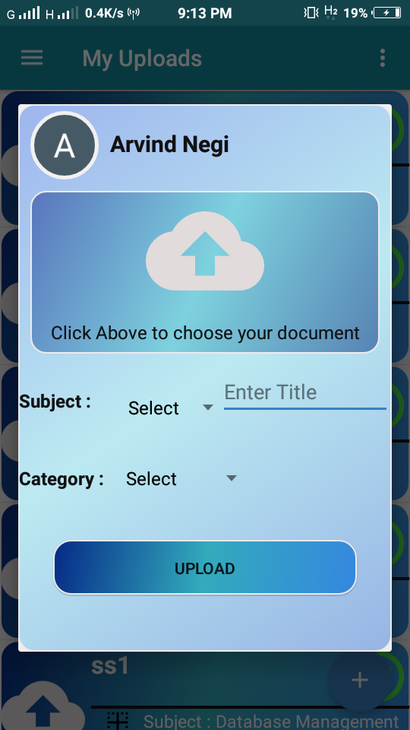
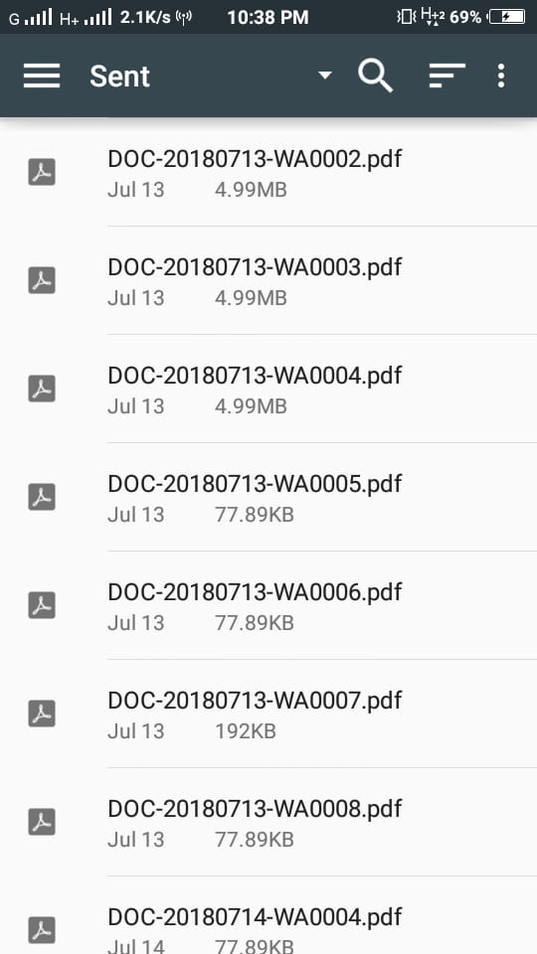

4-Dialog Fragment
A fragment that displays a dialog window, floating on top of it’s activity window.

Slide 14
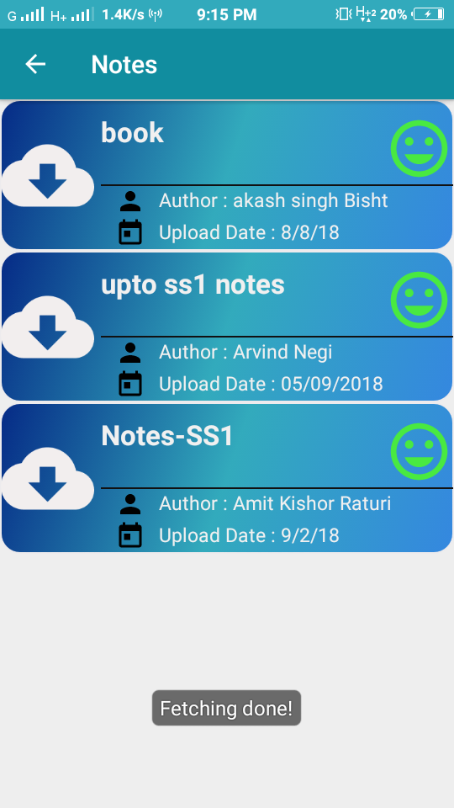
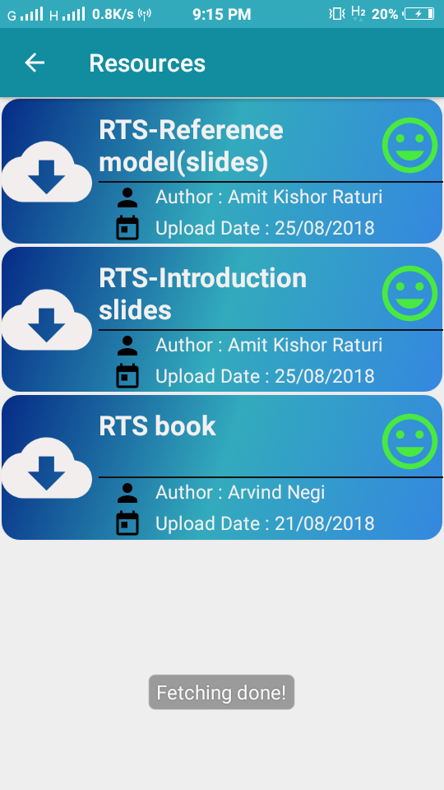
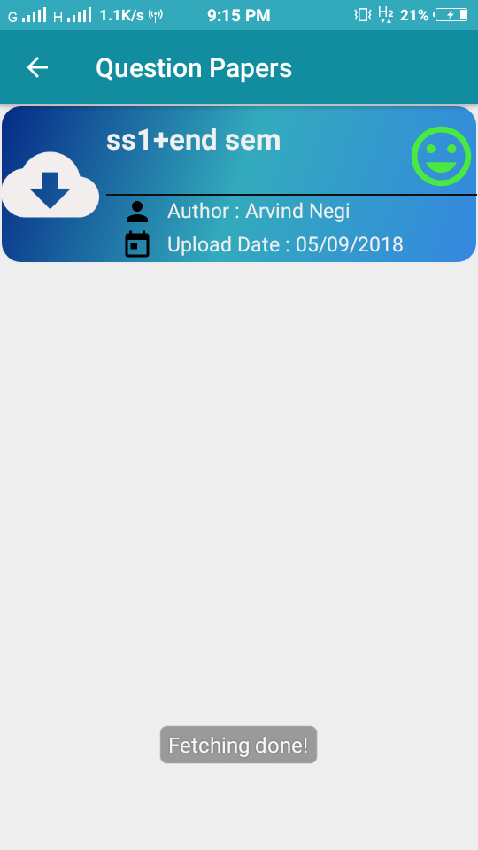
5- Recycler view
It is an advanced and flexible version of listview and grid view.
Used for displaying large amount of data sets that can be scrolled efficiently.
It Uses view holder mechanism.

Slide 15
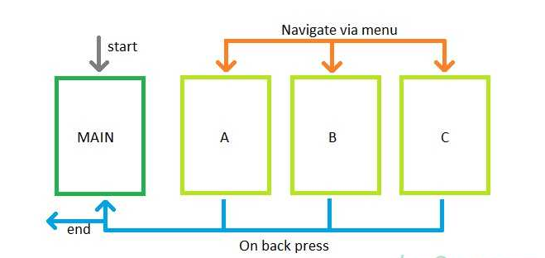
6- Fragment BackStack
Used to store the fragment into the stack.
Pressing back button of android device will return you the fragment that you saved in the stack.

Slide 16
FRONT-END DEVELOPMENT
Splash Screen
Layouts
Database ( SQLite)
Alert Dialog and Dialog Fragment
Features for Admin

Slide 17
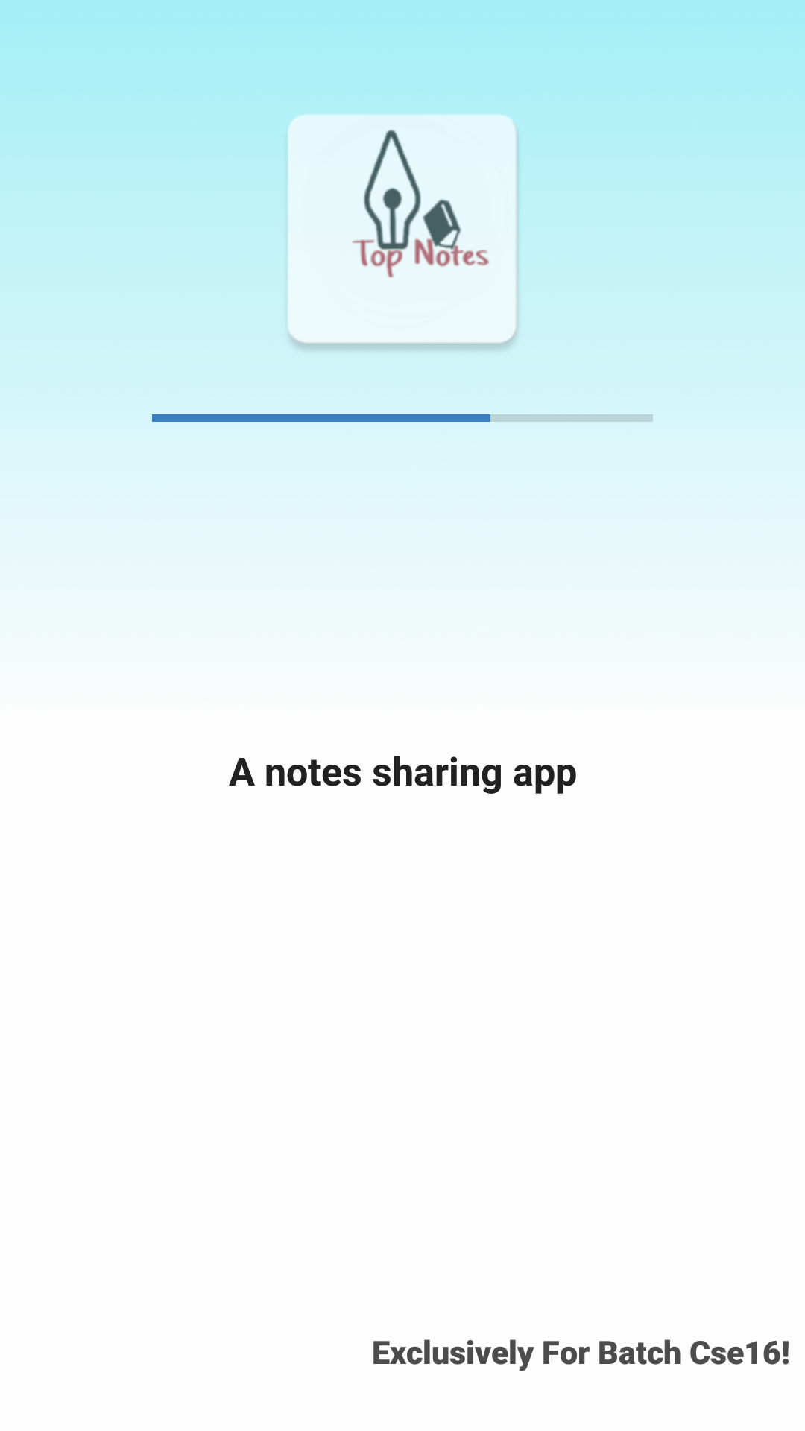
SPLASH SCREEN
Used For:
Fetching and parsing json/xml.
Checking of availability of network.
Downloading data and storing it in SQLite.
Downloading images.

Slide 18
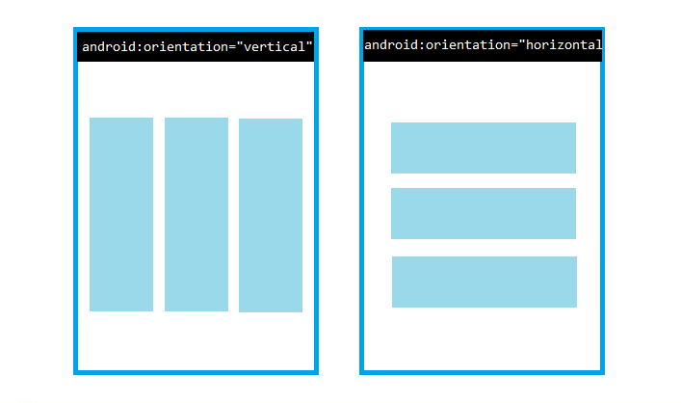
Layouts
Linear layout
A view group that aligns all children in a
single direction.
VERTICAL AND HORIZONTAL LINEAR LAYOUT

Slide 19
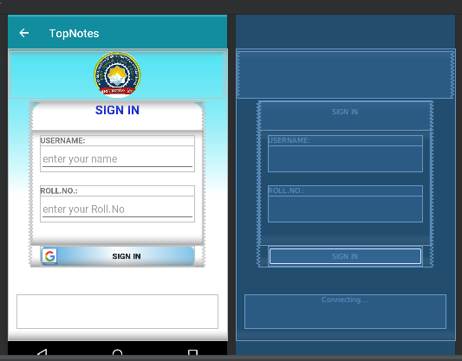
Implementation of linear layout (Login page)
Nested Linear Layout

Slide 20
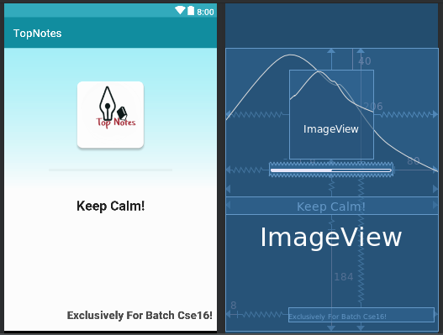
Constraint Layout
To create large and complex layouts with a flat view hierarchy (no nested view groups)

Slide 21
Database (SQLite)
Database name- TopNotes
Field Id Content SubjectType subjectName | Type int(11) BLOB Tinytext Tinytext | Null No Yes Yes Yes | Key PRI | Default NULL NULL NULL NULL | Extra
Database Structure

Slide 22
Serializable field 'Content' have attributes:
String title- Represent title of the content.
String author- Who upload the content.
String date- When content is uploaded.
String downloadUrl- to download the content.
String subject- Name of the subject to which content belong.
String size- File size.
int downloads- How many users download the file.
String fileName- Name of the file.

Slide 23
why SQLite Database?
To save the contents info fetched from the firebase.
Once contents are fetched:
a. Saved them in local database.
b. Show the local contents to user
when user run the app next time.
c. Fetch the latest contents in background

Slide 24
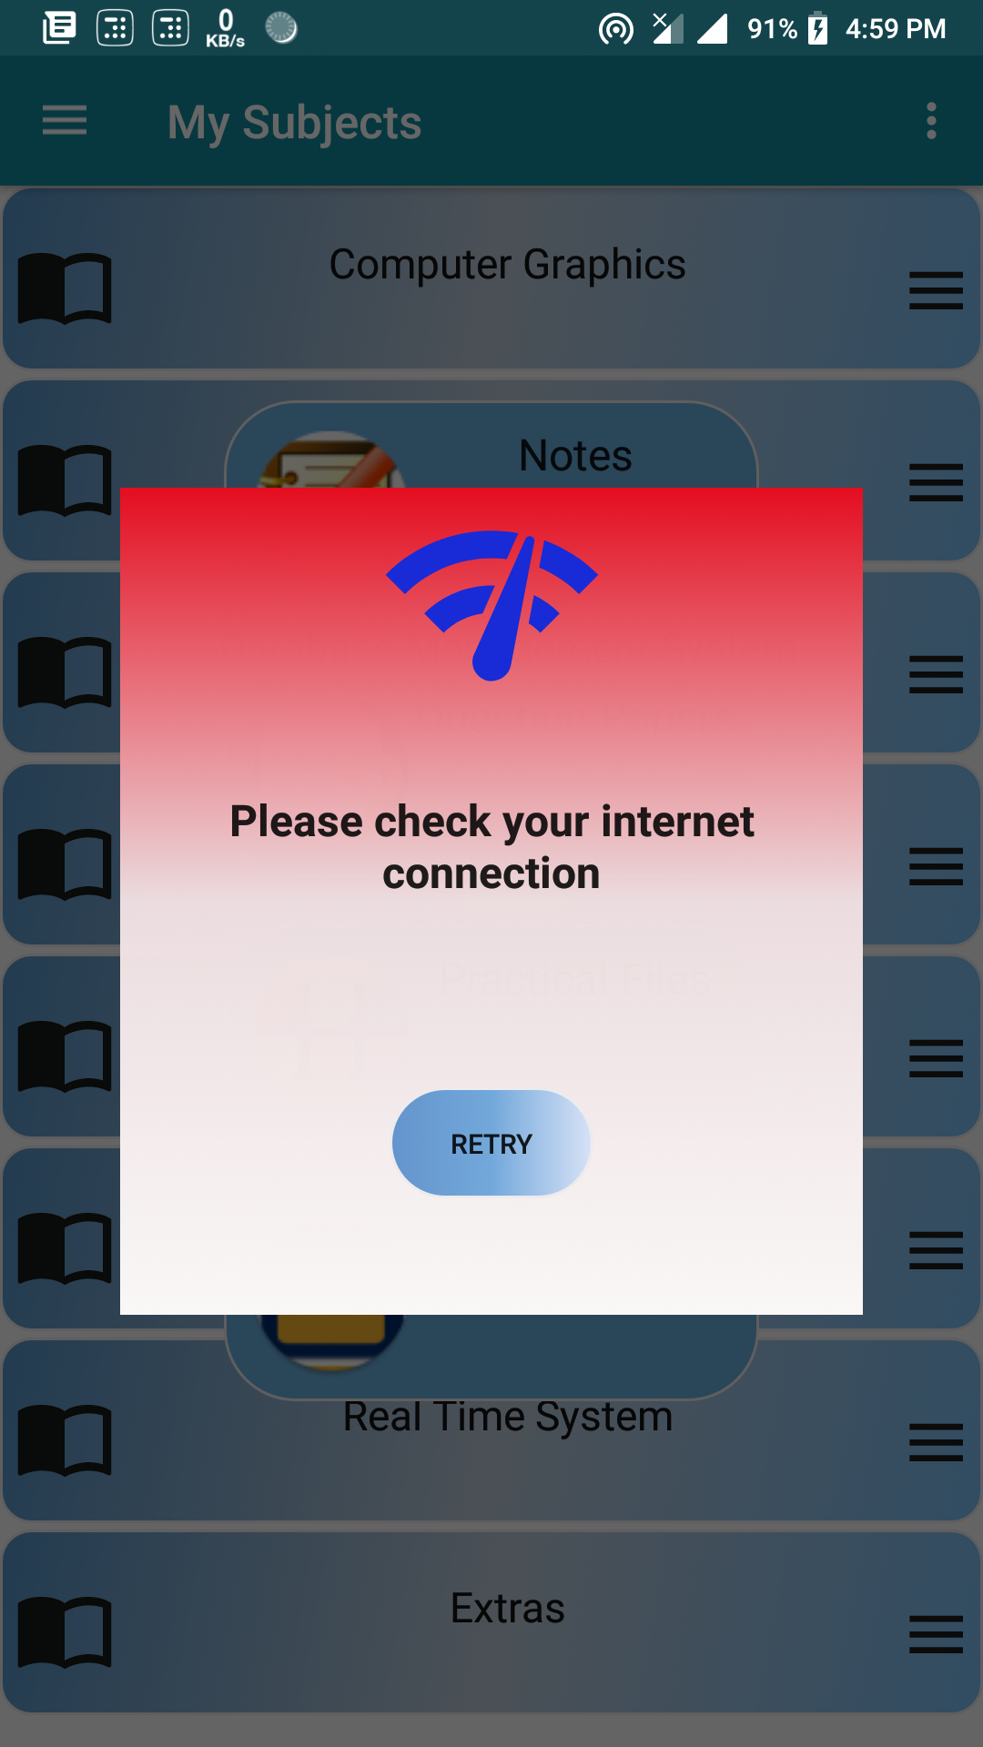
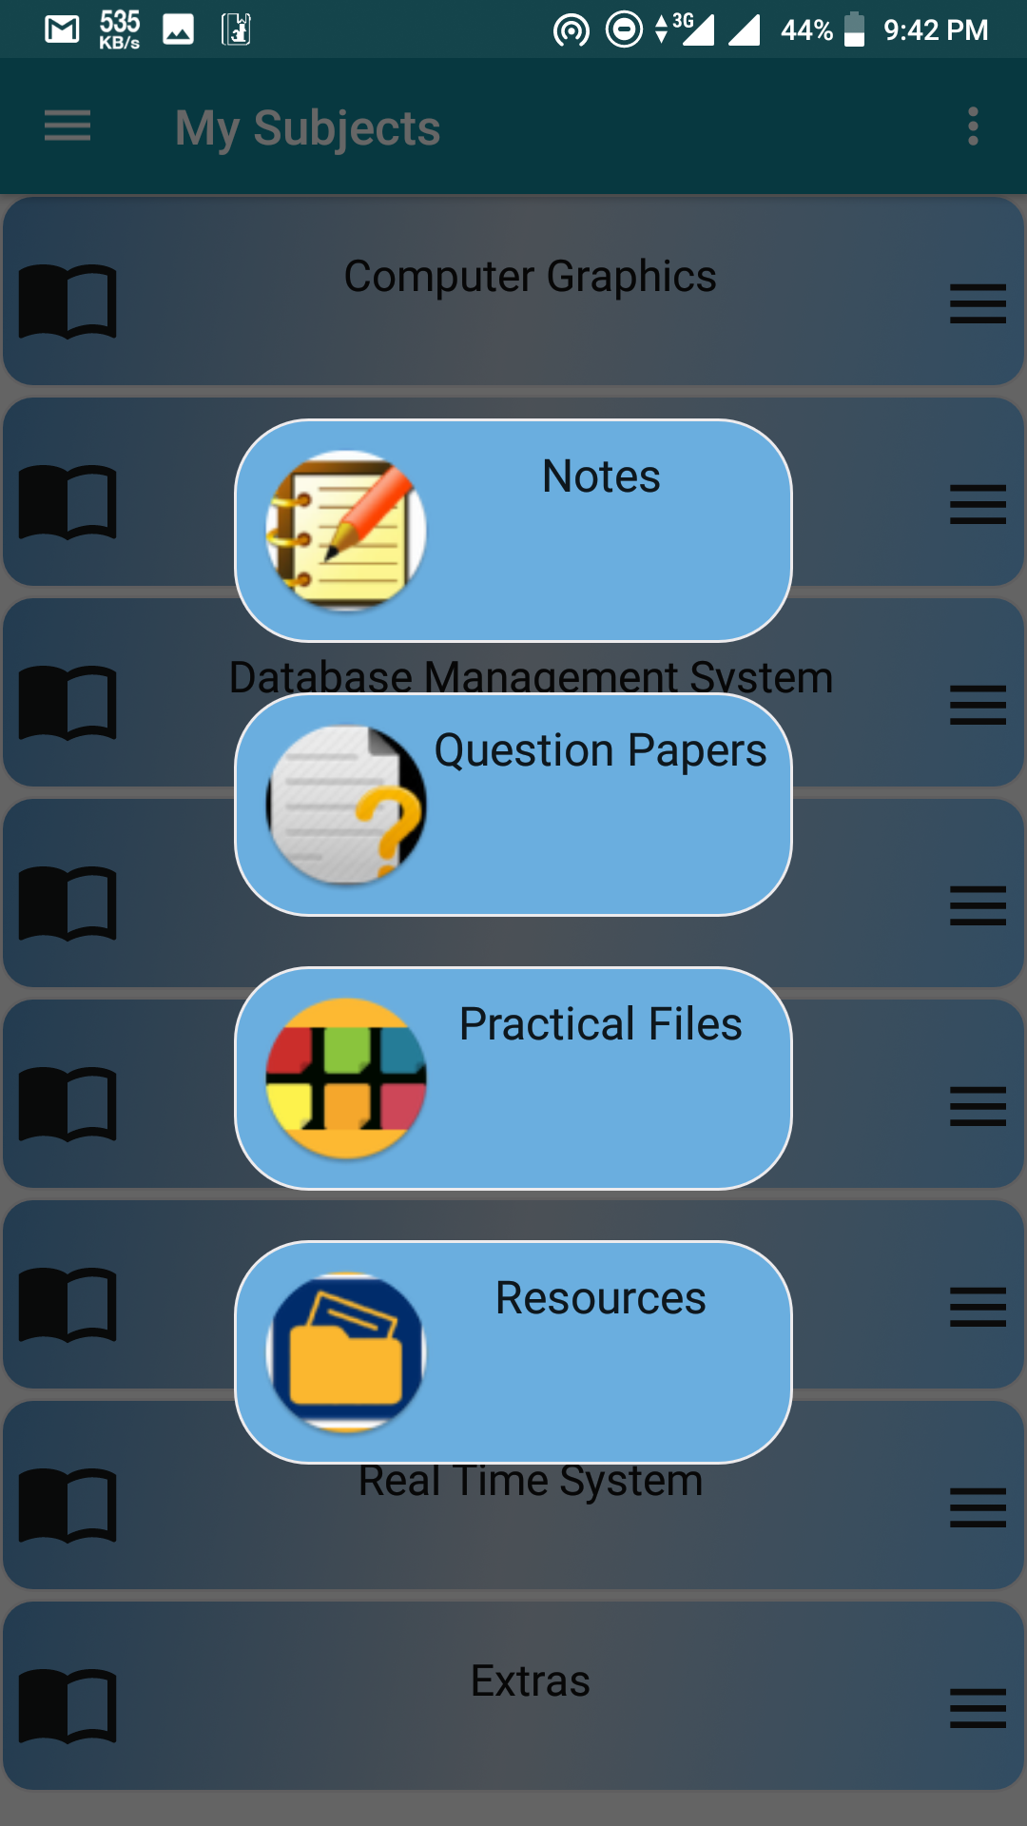
Alert dialog and Dialog fragment
If mobile data isn’t on an alert dialog will popup with an error message.

Slide 25
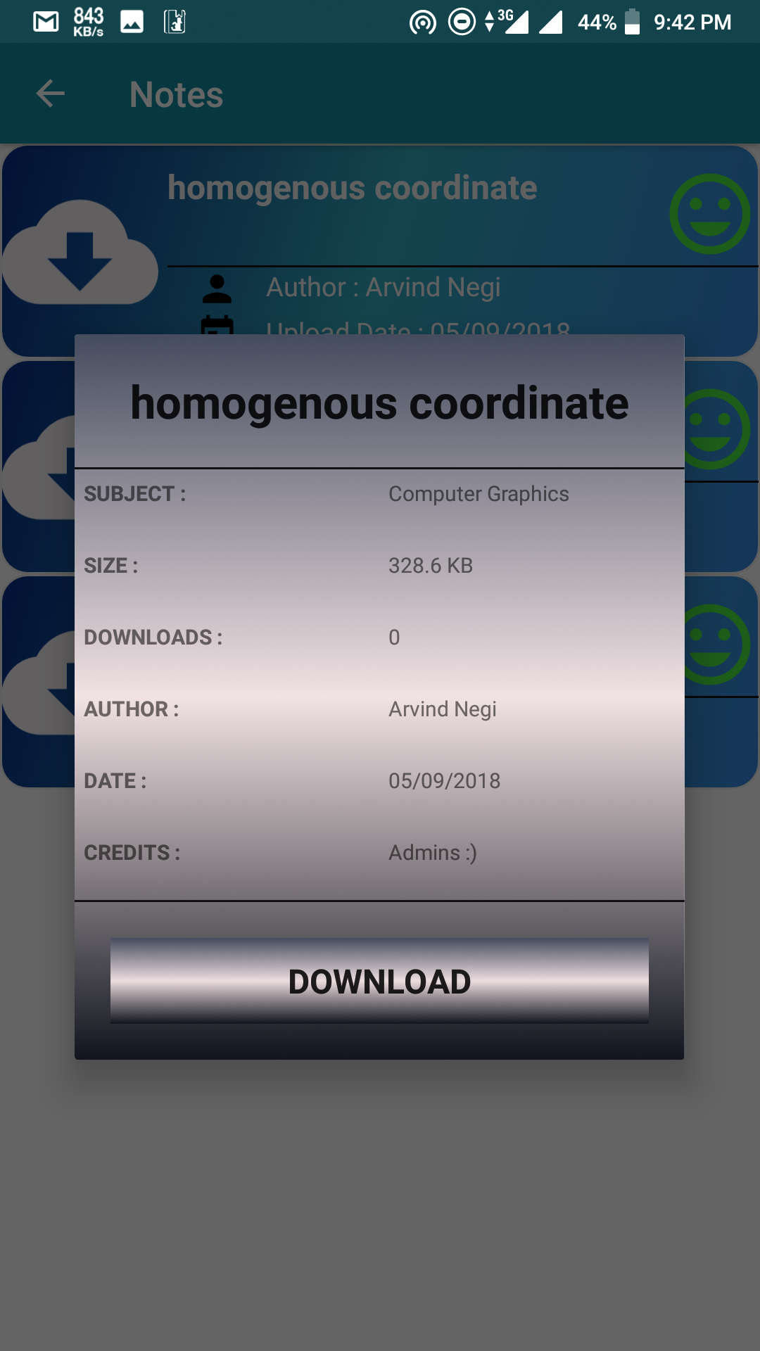
Dialog Fragment:
A fragment that displays
a dialog window.
Used for displaying the
Various information about
the File.
By pressing the download Button user can download the file.

Slide 26
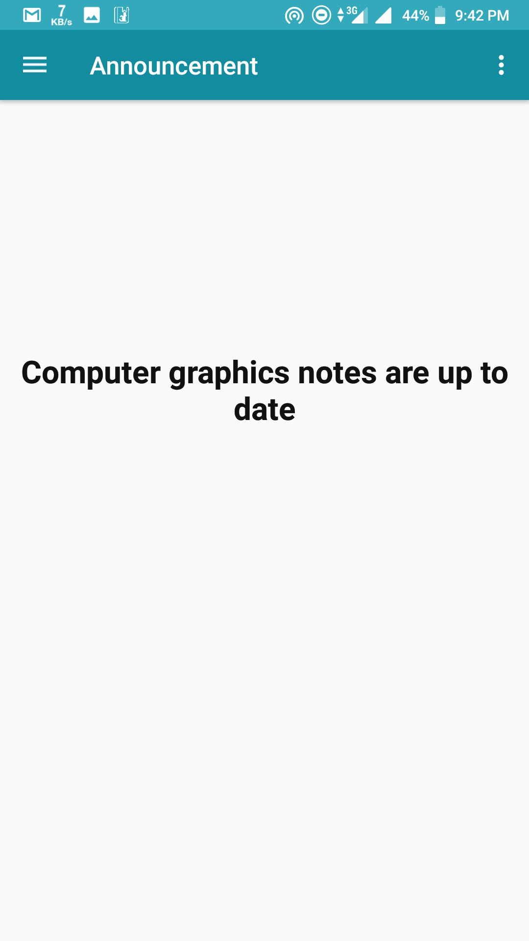
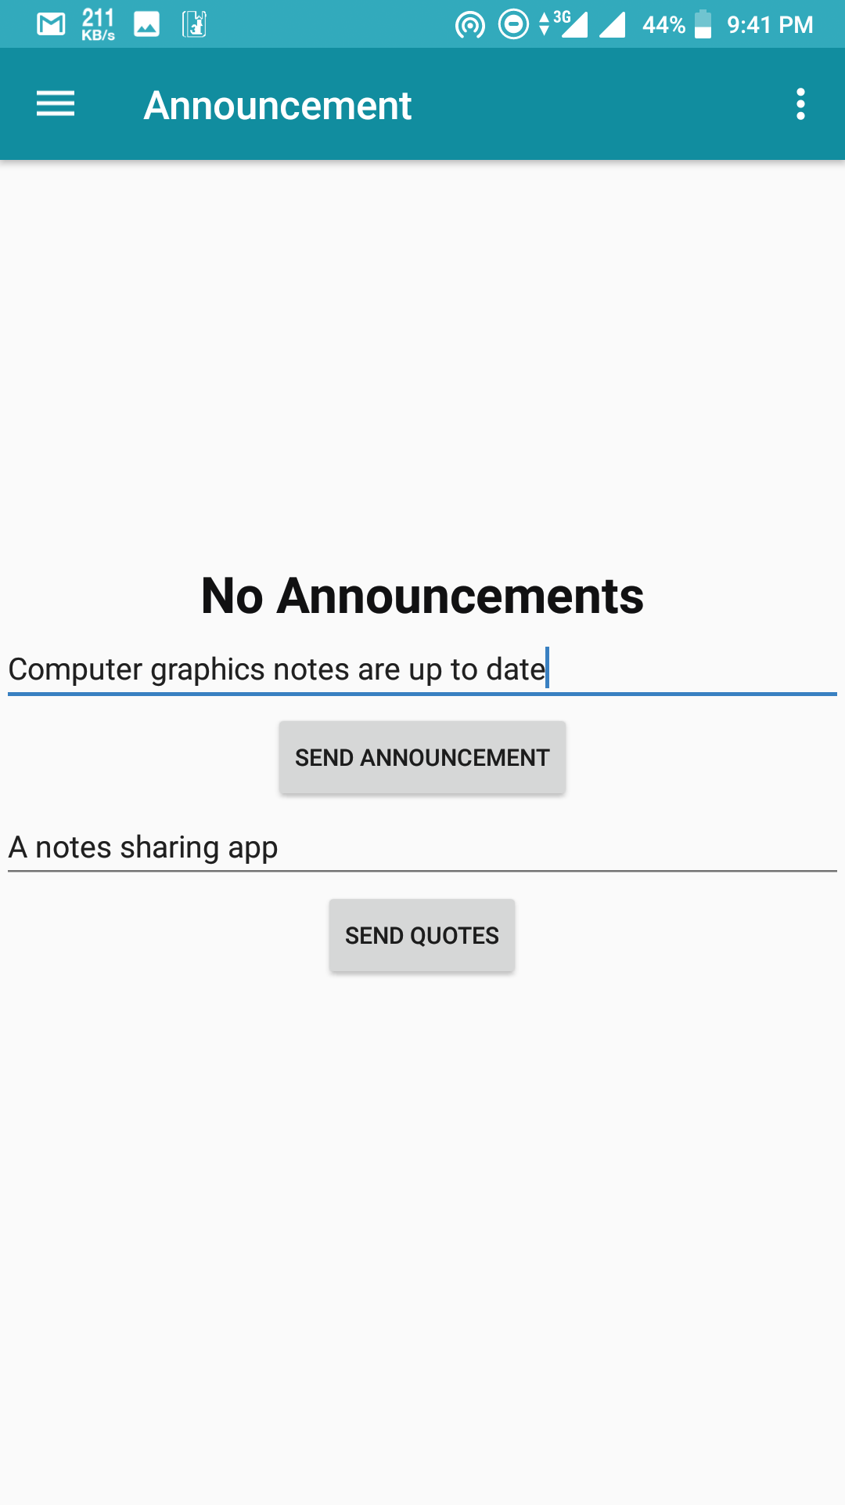
Features for Admin
Admin can send Announcement and quotes directly from the app itself.

Slide 27

A more flexible user interface with Android Material Design library is expected in its next release.
A push notification to the users when new notes are uploaded can be expected in its next release.
Subjects from departments other than CSE are also expected to be added in its next release.

Slide 28

 http://www.developer.android.com/
 http://blog.firebase.com/
 http://www.stackoverflow.com/

Slide 29


